Slide 1
Taxpayer Impact of Creation of a New High School and K-12 District in East Helena.
Jim Standaert
May 5, 2014
443-0620 - jestandaert@yahoo.com
T

Slide 2
Outline

Slide 3
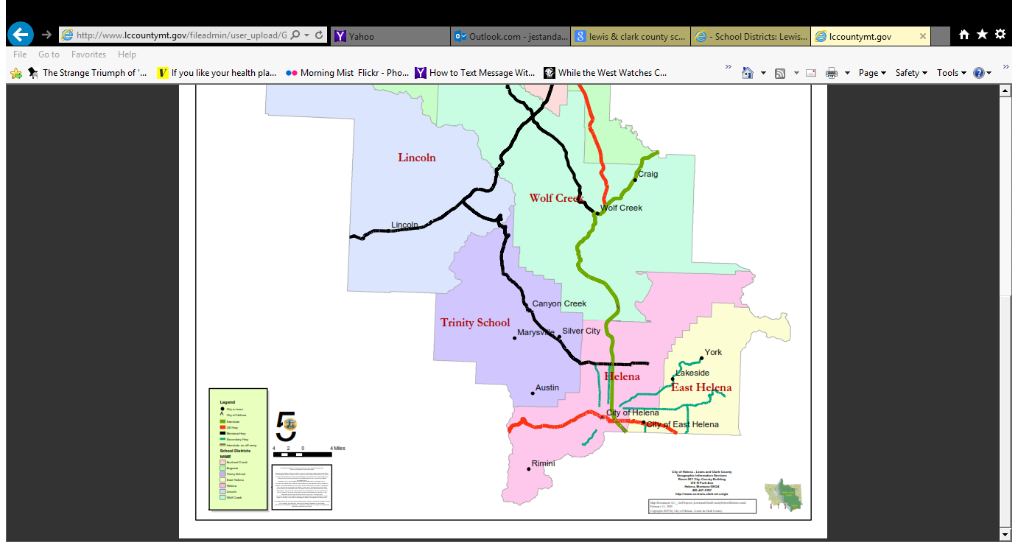
Very Rough Map of Current Helena HS and E. Helena Elementary

Slide 4
Taxable Value Helena HS, Helena Elem & E. Helena Elem 1994 - 2014

Slide 5
Assumptions

Slide 6
District General Fund Budgets – FY 2014 – Lowest Taxpayer Impact

Slide 7
Create New East Helena High School – Mill Change Summary

Slide 8
District General Fund Budgets – FY 2014 - Highest Taxpayer Impact (without a Vote)

Slide 9
Create New East Helena High School – Mill Change Summary –Highest Taxpayer Impact (without a vote)

Slide 10
State Fiscal Impact of Creation of New E. Helena K-12 District

Slide 11
Why do State Costs go up in the Long Run
East Helena HS will receive a new Basic Entitlement that is greater than the reduction in the basic entitlement that Helena HS will experience ($290,000 for E. Helena HS vs loss of $84,000 for Helena HS). The state’s share will increase commensurately.
The per-ANB entitlement for East Helena HS is larger than it is for Helena HS, because the decrement for East Helena HS is smaller than for Helena HS.
Each Helena student not counted would have given Helena HS $6,155 per ANB in budget authority in FY 2014. The average student in the new East Helena High school will receive $6,290 per ANB in budget authority, an increase of $135 per ANB. The state’s share will increase commensurately.
East Helena’s taxable value per student is lower than it is for Helena HS. Therefore state GTB per student will be higher for East Helena HS than it is for Helena HS

Slide 12
Debt Service Guaranteed Tax Base Aid

Slide 13
Debt Service Guaranteed Tax Base Aid

Slide 14
Bonded Indebtedness Capacity

